Slide 1

B.Tech I-Year II-Sem
Subject: UI FRAMEWORKS
(MR23-1CS0106)

Slide 2
UNIT-III ANGULAR

Slide 3

Syllabus UNIT III ANGULAR
Introduction of Angular
Angular Installation
Creating basic Angular Application
Modules and Components
built-in Directives,
Angular Routing.

Slide 4
Angular Introduction
Angular is a JavaScript (actually a TypeScript based open-source full-stack web application) framework which makes you able to create reactive Single Page Applications (SPAs).
Angular is completely based on components. It consists of several components which forms a tree structure with parent and child components.
Angular's versions beyond 2+ are generally known as Angular only. The very first version Angular 1.0 is known as AngularJS.

Slide 5
Difference between Angular and React
Sl.No | ANGULAR | REACT
1 | Angular is a TypeScript based JavaScript framework. It is written in TypeScript. | React is not a framework. It is a JavaScript library for building user interfaces.
2 | Angular is developed and maintained by Google. It was released in 2010 by google | React is developed and maintained by Facebook. It was released in 2013 by facebook.
3 | Angular is a full MVC (Model, View, and Controller) framework. | React is a simple JavaScript library
4 | Angular uses regular DOM. The regular DOM updates the entire tree structure of HTML tags. | React uses virtual DOM which makes it amazing fast.
5 | Angular provides two-way data binding. | React provides one-way data binding.
6 | Angular is fast as compared to old technologies | React is faster than Angular.
7 | The size of Angular is large, so it takes longer load time and performance on mobile. | The size of React is smaller than Angular, so it is a little bit faster.
8 | Companies using Angular - Google, Nike, Forbes | Companies using React - Facebook, Airbnb, Uber, Netflix, Instagram, WhatsApp

Slide 6
Angular Features
Two-Way Data Binding: AngularJS introduced two-way data binding, enabling automatic synchronisation between the model and the view, creating a seamless and responsive user interface with minimal code.
MVC Architecture: AngularJS follows the Model-View-Controller (MVC) architectural pattern, providing a structured approach to application design and development, enhancing code organisation and maintainability.
Dependency Injection: AngularJS facilitates dependency injection, allowing components to be injected with their dependencies, which promotes reusability, testability, and modular development.
Directives for Extending HTML: Directives in AngularJS extend the HTML vocabulary, enabling the creation of custom, reusable components and behaviours, resulting in a modular and extensible development approach.
Modular Design: AngularJS promotes modular design, allowing the development of independent and reusable components that can be combined to build complex applications, enhancing scalability and maintainability.
Active Community Support: The AngularJS community provides active support, fostering collaboration, knowledge sharing, and the development of a rich ecosystem of tools, resources, and best practices.

Slide 7
Model View Controller(MVC):
It consists of three components:
Model: This component consists of a database & is responsible for managing the data & logic of the application. It responds to the request made by the View component & the instruction given by the Controller component, in order to update itself.
View: This component is responsible for displaying the application data to the users. The View is basically the user interface that helps to render the required data to the user, with the help of the AngularJS expressions.

Slide 8
Controller:
This component is responsible for communicating & interacting between the Model & the View Component, i.e. its main job is to connect the model and the view component.
It helps to validate the input data by implementing some business logic that manipulates the state of the data model.

Slide 9


Slide 10
Angular Installation
Prerequisites for Installation:
Node.js: Required for npm and Angular CLI.
npm (Node Package Manager): Manages packages and dependencies.
Angular CLI: Command-line interface for Angular.

Slide 11
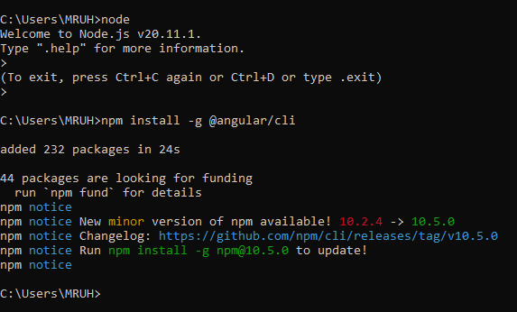
Angular Installation
Step 1:
Install Node.js
Step 2:
Install Angular by typing the following command in the command prompt window
npm install –g @angular/cli

Slide 12
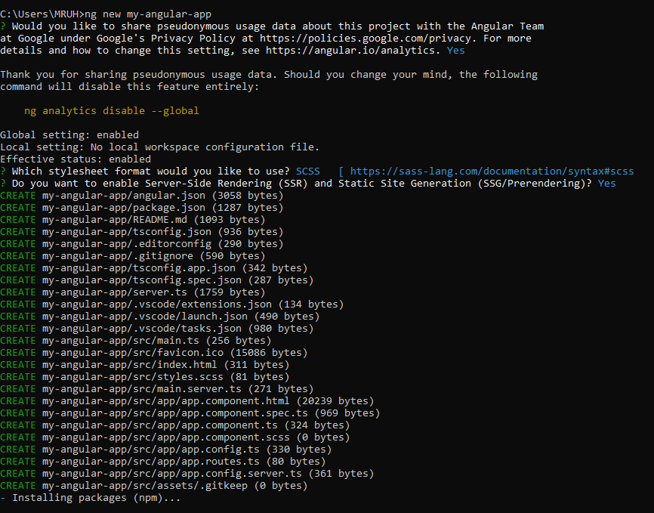
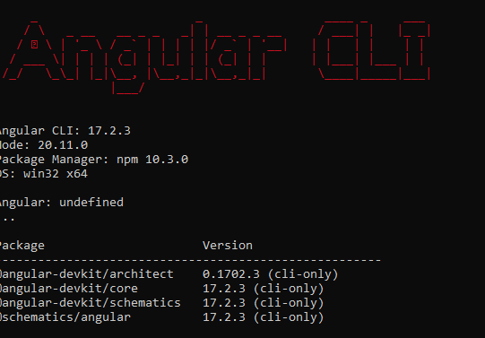
Angular Installation
Step 3:
Create Angular App by typing the following in the command prompt window:
ng new my-angular-app
A new Angular app with the name “my-angular-app” will be created.
NOTE: To check whether Angular is installed or not , type the following in the command prompt:
ng version

Slide 13
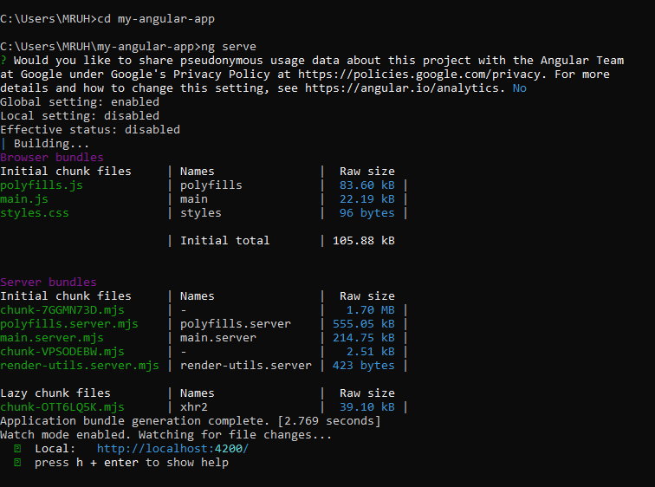
Angular Installation
Step 4:
To change directory and go inside the app folder type the following:
C:\Users\MRUH> cd my-angular-app
Step 5:
To compile and run the app do the following:
C:\Users\MRUH\cd my-angular-app> ng serve

Slide 14
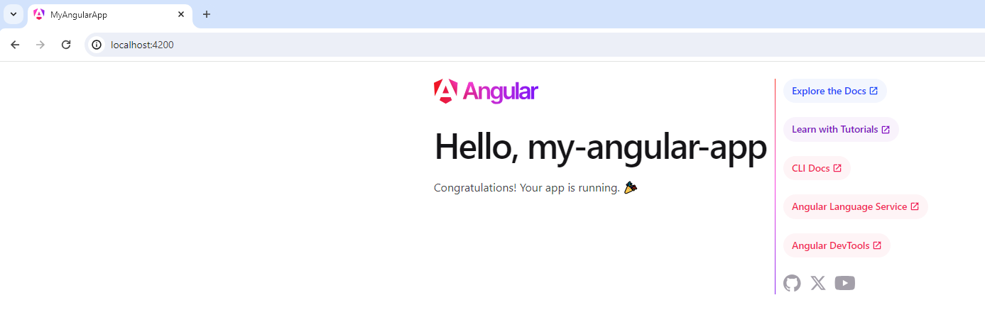
Angular App - OUTPUT
The output will be displayed at the following Local host address: http://localhost:4200/

Slide 15
Angular components
Components are the main building blocks for Angular applications. Each component consists of:
An HTML template that declares what renders on the page
A TypeScript class that defines behavior
A CSS selector that defines how the component is used in a template
Optionally, CSS styles applied to the template

Slide 16
Creating a component using the Angular CLI
From a terminal window, navigate to the directory containing your application.
Run the following command
ng generate component <component-name>
ng g c <component-name> → Shortcut Command
where <component-name> is the name of your new component.
By default, this command creates the following:
A directory named after the component
A component file, <component-name>.component.ts
A template file, <component-name>.component.html
A CSS file, <component-name>.component.css
A testing specification file, <component-name>.component.spec.ts

Slide 17
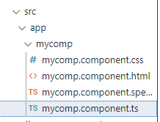
How to use components?
Step 1: Navigate to the directory containing your app and type the following:
C:\Users\MRUH\angularfolder\myapp> ng g c mycomp
Note: Angular creates a new folder with the name “mycomp” with the following files in it:

Slide 18
How to use components?
Step 2: Verify the 4 files generated by default and don’t do any changes to the existing files
mycomp.component.ts file:
import { Component } from '@angular/core';
@Component({
selector: 'app-mycomp',
standalone: true,
imports: [],
templateUrl: './mycomp.component.html',
styleUrl: './mycomp.component.css'
})
export class MycompComponent {
}
Don’t do any changes to this file

Slide 19
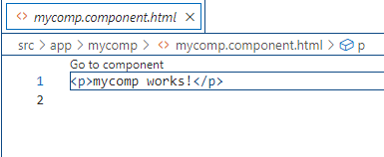
How to use components?
Step 2: Verify the 4 files generated by default and don’t do any changes to the existing files
mycomp.component.html file:
Don’t do any changes to this file

Slide 20
How to use components?
Step 3: After creating the component, open app.component.ts file and import the component created into this file as follows:
app.component.ts file:
import { Component } from '@angular/core';
import { RouterOutlet } from '@angular/router';
import {MycompComponent} from './mycomp/mycomp.component'
@Component({
selector: 'app-root',
standalone: true,
imports: [RouterOutlet, MycompComponent],
templateUrl: './app.component.html',
styles: ['h1 { color: red; }']
})
export class AppComponent {
title = 'myapp';
}

Slide 21
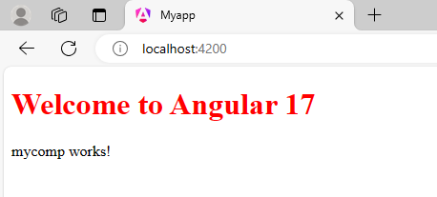
How to use components?
Step 4: open app.component.html file and render the name of the selector “app-mycomp”
in the app.component.html file.
app.component.html file:
<h1> Welcome to Angular 17 </h1>
<app-mycomp> </app-mycomp>
OUTPUT

Slide 22
Modules and Components
Modules
Angular 17 is standalone:true which means its not dependent on modules, it can be injected anywhere and used anywhere in the application.
Angular 16 and below have one mandatory
App module(standalone:false)
It is not mandatory to have App module in Angular17
If we need module it can be created by giving
ng new my-angular-app --no--standalone in command prompt

Slide 23
Modules creation
Another method to create module
ng generate module <name of the module>
Created module named users inside src
cd src
ng generate module <name of the module>

Slide 24
Modules
Modules does not have any code it contains only reference files.
Here in Angular, Module is a unit that groups Components, Pipes, Directives, and Services.
Minimum one module present in every angular application, which is NgModule.
NgModule is AppModule and is present in app.module.ts file.

Slide 25
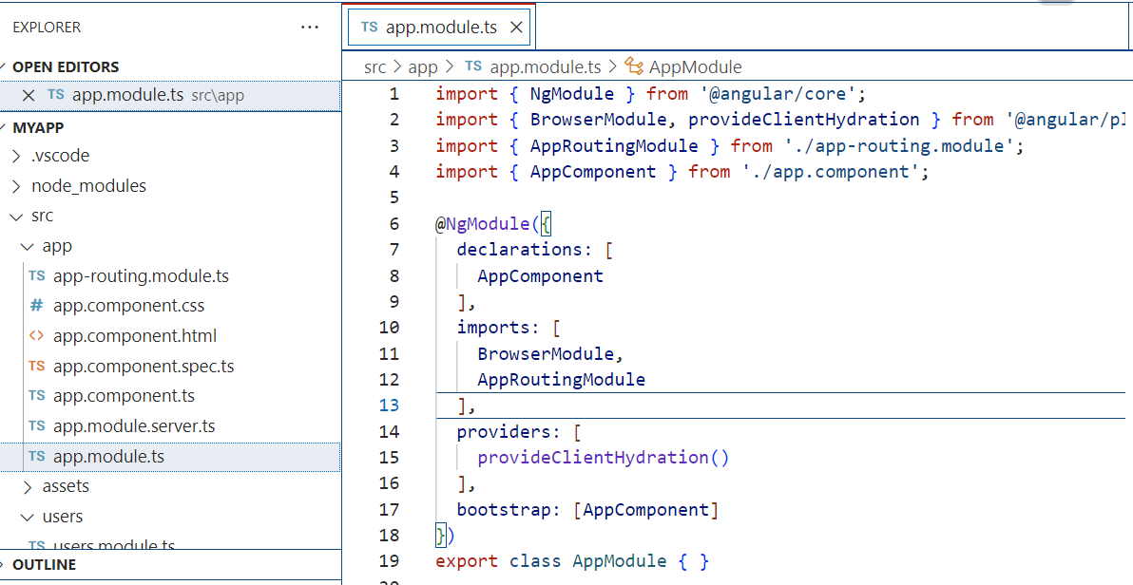
Import and export functionalities from one module to the other for efficient and clean programming.

Slide 26
Functionalities of Modules in Angular
Declarations: This one contains the name of components, pipes, and directives which are present in the NgModule.
Components are the building blocks of Angular applications-reusable code
Pipes are used to transform data before it is displayed in a template. For example, a pipe could be used to format a date, currency, or number
Directives are used to modify the behavior of HTML elements. For example, a directive could be used to add validation to a form field, or to toggle the visibility of an element.

Slide 27
Example
A component could be used to display a list of products.
A pipe could be used to format the prices of the products in the list.
A directive could be used to add a "Buy Now" button to each product in the list.
Imports: This contains the names of other modules whose functionalities are required by the components of this particular module.
Browse module-functionalities required by the angular app to work. These functionalities are Directives, services, and pipes.
Exports: This is responsible for making the component template visible to other modules that can import functionalities from this Module.

Slide 28
Providers: When NgModule runs, its main function is to provide the application with services. The provider is responsible for creating Services that the NgModule requires. The services are accessible from all parts of the App.
Bootstrap: This is the Property of Root Module. Bootstrapping is the process which initializes the root module. The root module is responsible for initializing all the other modules.

Slide 29
Angular- Built in Directives
Directives are classes that add additional behavior to elements in your Angular applications.
Angular built-in directives are used to manage forms, lists, styles, and what users see.
Types of Directives:
Structural Directives - ngIf (ngIf, ngIf-else, ngIf-then-else), ngFor, ngSwitch
Attribute Directives- ngClass, ngStyle, ngModel
Component Directives

Slide 30
1. Structural Directives
Structural Directives Change the DOM layout by adding and removing DOM elements.
Usually changes in the DOM structure are done using Javascript in HTML, but in Angular DOM changes are done in the .html file only.
Types of Structural Directives:
ngIf → ngIf, ngIf-else, ngIf-then-else
ngFor
ngSwitch
NOTE:
For using directives inside an html tag we need to add a prefix ‘*’ Eg: <h1 *ngIf> </h1>

Slide 31
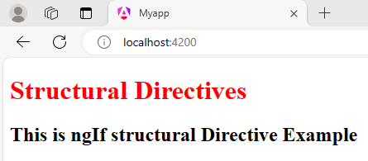
1. Structural Directives- ngIf - Example
app.component.ts file:
import { Component } from '@angular/core';
import {CommonModule} from '@angular/common';
@Component({
selector: 'app-root',
standalone: true,
imports: [CommonModule],
templateUrl: './app.component.html',
styles: ['h1 { color: red; }']
})
export class AppComponent {
data="abc"
}
app.component.html file:
<h1> Structural Directives </h1>
<h2 *ngIf="data">This is ngIf structural Directive Example</h2>

Slide 32
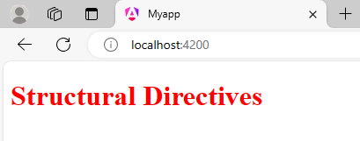
1. Structural Directives- ngIf - Example
app.component.ts file:
import { Component } from '@angular/core';
import {CommonModule} from '@angular/common';
@Component({
selector: 'app-root',
standalone: true,
imports: [CommonModule],
templateUrl: './app.component.html',
styles: ['h1 { color: red; }']
})
export class AppComponent {
title = 'myapp';
data=""
}
app.component.html file:
<h1> Structural Directives </h1>
<h2 *ngIf="data">This is ngIf structural Directive Example</h2>
Output when data=“ ” ie NULL data:

Slide 33
ngIf –else: Example
app.component.ts file:
import { Component } from '@angular/core';
import {CommonModule} from '@angular/common';
@Component({
selector: 'app-root',
standalone: true,
imports: [CommonModule],
templateUrl: './app.component.html',
styles: ['h1 { color: red; }']
})
export class AppComponent {
data=['CSE', 'AIML', 'DS', 'CS']
}
app.component.html file:
<h1> Structural Directives </h1>
<h2 *ngIf="!data else sample">Loading.......</h2>
<ng-template #sample>
<h2>This ngIf-else Example</h2>
<h1>{{data}}</h1>
</ng-template>

Slide 34
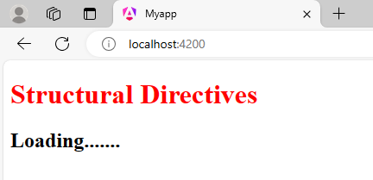
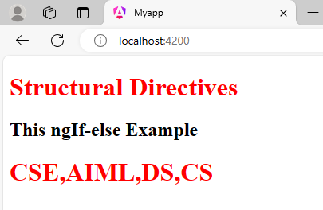
ngIf –else: Example -OUTPUT
If data=“ ” :
If data= =['CSE', 'AIML', 'DS', 'CS']:

Slide 35
ngFor:
The ngForOf directive is generally used in the shorthand form *ngFor.
In this form, the template to be rendered for each iteration is the content of an anchor element containing the directive.

Slide 36
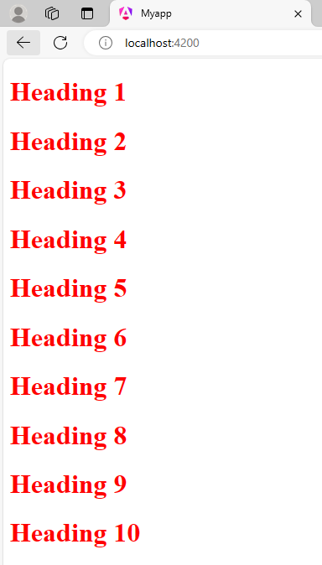
ngFor:
app.component.ts file:
import { Component } from '@angular/core';
import {CommonModule} from '@angular/common';
@Component({
selector: 'app-root',
standalone: true,
imports: [CommonModule],
templateUrl: './app.component.html',
styles: ['h1 { color: red; }']
})
export class AppComponent {
nums=[1,2,3,4,5,6,7,8,9,10]
}
app.component.html file:
<h1 *ngFor ="let n of nums">Heading {{n}}</h1>

Slide 37
ngSwitch:
Switch (expression) {
case value1:
statement1;
break;
case value2:
statement2;
break;
case value3:
statement3;
break;
default:
statement;
}
The [ngSwitch] directive on a container specifies an expression to match against.
The expressions to match are provided by ngSwitchCase directives on views within the container.
Every view that matches is rendered.
If there are no matches, a view with the ngSwitchDefault directive is rendered.

Slide 38
ngSwitch: Example
app.component.ts file:
import { Component } from '@angular/core';
import {CommonModule} from '@angular/common';
@Component({
selector: 'app-root',
standalone: true,
imports: [CommonModule],
templateUrl: './app.component.html',
styles: ['h1 { color: red; }']
})
export class AppComponent {
num1:number =10;
num2:number=3;
operation: string='*'
}

Slide 39
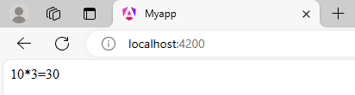
ngSwitch: Example
app.component.html file:
<div [ngSwitch]="operation">
<div *ngSwitchCase="'+'">{{num1}}+{{num2}}={{num1+num2}}</div>
<div *ngSwitchCase="'-'">{{num1}}-{{num2}}={{num1-num2}}</div>
<div *ngSwitchCase="'*'">{{num1}}*{{num2}}={{num1*num2}}</div>
<div *ngSwitchCase="'/'">{{num1}}/{{num2}}={{num1/num2}}</div>
<div *ngSwitchDefault="'+'">{{num1}}+{{num2}}={{num1+num2}}</div>
</div>

Slide 40
2. Attribute Directives
Attribute directives changes the appearance or behavior of a DOM element.
These directives look like regular HTML attributes in templates.
Types of Attribute Directives:
ngStyle
ngClass
ngModel

Slide 41
2. Attribute Directives-ngStyle
Based on the component state, dynamic styles can be applied by using ngStyle
Many inline styles can be set by binding to ngStyle.
App.component.html:
<div style = "text-align: center;">
<h1> WELCOME TO ANGULAR</h1>
<div style ="background-color: blue;"> Hello !!! Welcome to Attribute Directive class</div>
<h1 [ngStyle]="{'background-color': myvar=='CSE' ? 'green':'red'}">ngstyle-attribute</h1>

Slide 42
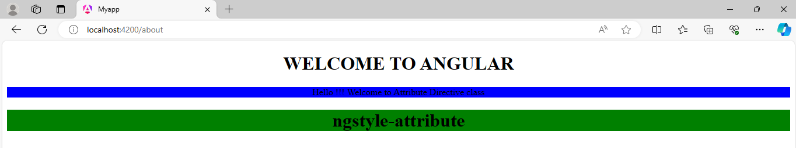
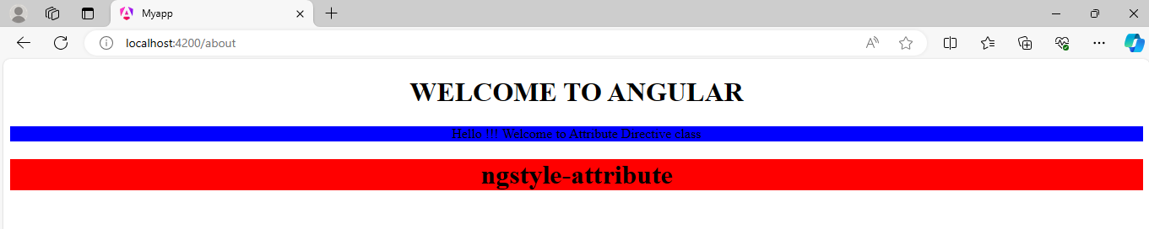
2. Attribute Directives-ngStyle
App.component.ts:
import { Component } from '@angular/core';
import { CommonModule } from '@angular/common';
@Component({
selector: 'app-root',
standalone: true,
imports: [CommonModule],
templateUrl: './app.component.html',
})
export class AppComponent {
myvar='AIML'
}
NOTE:
If myvar =CSE , background-color of <h1> tag is green otherwise red will be selected.

Slide 43
2. Attribute Directives-ngClass
The ngClass directive is used to dynamically set CSS classes on an HTML element by databinding an expression that represents all classes to be added.
The directive operates in three different ways, depending on which of three types the expression evaluates to:
If the expression evaluates to a string, the string should be one or more space-delimited class names.
If the expression evaluates to an object, then for each key-value pair of the object with a truthy value the corresponding key is used as a class name.
If the expression evaluates to an array, each element of the array should either be a string as in type 1 or an object as in type 2.

Slide 44
2. Attribute Directives-ngClass (Example)
App.component.css:
.one{
background-color: aquamarine;
color: red;
}
.two{
background-color: #ff7fb4;
}
.three{
background-color: rgb(127, 255, 138);
color: rgb(88, 12, 228);
font-size: 60px;
}
.four{
background-color: rgb(181, 219, 13);
color: rgb(228, 91, 12);
font-size: 80px;
}

Slide 45
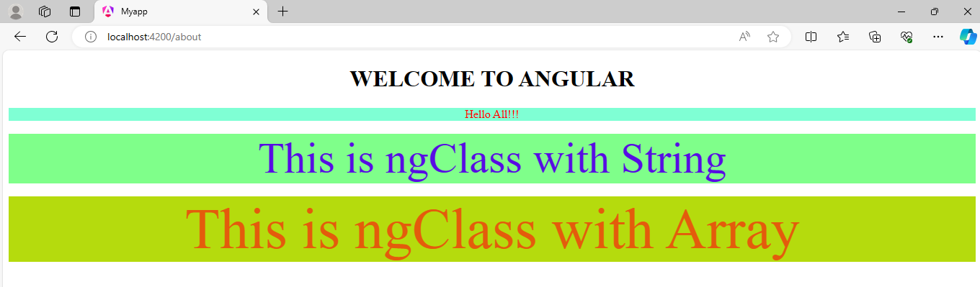
2. Attribute Directives-ngClass (Example)
App.component.html:
<div style = "text-align: center;">
<h1> WELCOME TO ANGULAR</h1>
<! ----- ngClass with String >
<div class="one">Hello All!!!</div> <br>
<div [ngClass]="'one three'">This is ngClass with String</div> <br>
<! ----- ngClass with Array >
<div [ngClass]="['one', 'four']">This is ngClass with Array</div>

Slide 46
2. Attribute Directives-ngModel
The ngModel directive is a directive that is used to bind the values of the HTML controls (input, select, and textarea) or any custom form controls, and stores the required user value in a variable and we can use that variable whenever we require that value.
It also is used during form validations.
The various form input types (text, checkbox, radio, number, email, URL, date, datetime-local time, month, week) can be used with the ngModel directive.
This directive is supported by <input>, <select> & <textarea>.

Slide 47
3.Component Directives:
Used with a template. This type of directive is the most common directive type.
@Component({
selector: 'app-root',
standalone: true,
imports: [CommonModule],
templateUrl: './app.component.html',
styleUrl: './app.component.css'
})

Slide 48
ANGULAR ROUTING
Angular Router is used to handle the navigation from one view to the next.
The Router enables navigation by interpreting a browser URL as an instruction to change the view.
Basic Steps in Routing:
Creating the components which are to be linked through Routing
Configuring the Routes
Adding Routes in template.
Adding Router Outlet and RouterLink

Slide 49
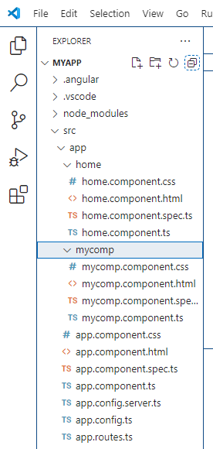
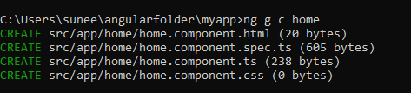
ANGULAR ROUTING
Step 1: Create the following components using the command
ng g c <component_name>
home
about
contact
Creating home component: ng g c home
Note: In the same manner, create ‘about’ and ‘contact’ components

Slide 50
ANGULAR ROUTING
Home Component Files:
home.component.html file:
<h1>This is Home Page of my Angular APP</h1>
home.component.css file:
h1{
background-color: rgb(67, 15, 211);
color: white;
}

Slide 51
ANGULAR ROUTING
About Component Files:
about.component.html file:
<h1>ABOUT MALLA REDDY UNIVERSITY</h1>
<p>Malla Reddy University, Hyderabad (As per Telangana State Private Universities Act No. 13 of 2020, Higher Education (UE) Department dt. 15.6.2020) was established in the year 2020 through the State Legislature Council of Telangana, Govt. of Telangana. It is offering industry-focused specialised Undergraduate and Postgraduate courses with the aim of providing Quality Higher Education on par with International standards. It persistently seeks and adopts innovative methods to improve the quality of higher education on a consistent basis.</p>
about.component.css file:
h1{
background-color: rgb(67, 15, 211);
color: white;
}

Slide 52
ANGULAR ROUTING
Contact Component Files:
contact.component.html file:
<h1>contact Component</h1>
<p>Maisammaguda, Dulapally, Hyderabad, Telangana 500100<br> Phone: 94971-94971, 91778-78365</p>
contact.component.css file:
h1{
background-color: bisque;
}

Slide 53
ANGULAR ROUTING
Step 2: Configuring the Routes
The Routes are configured in the app.component.html file using routerLink.
app.component.html file:
<div style = "text-align: center;">
<h1> WELCOME TO MRUH</h1>
<div>
<a routerLink ="home">Home</a> |
<a routerLink ="about">About</a> |
<a routerLink ="contact">Contact Us</a> |
</div>
<router-outlet></router-outlet>
</div>

Slide 54
ANGULAR ROUTING
Step 3: Adding Routes in template.
The paths for the Routes are provided in the app.routes.ts file.
app.routes.ts file:
import { Routes } from '@angular/router';
import { HomeComponent } from './home/home.component';
import { AboutComponent } from './about/about.component';
import { ContactComponent } from './contact/contact.component';
export const routes: Routes = [
{path:'home', component:HomeComponent},
{path:'about', component:AboutComponent},
{path:'contact', component: ContactComponent}
];

Slide 55
ANGULAR ROUTING
Step 4: Adding Router Outlet and RouterLink
app.component.ts file:
import { Component } from '@angular/core';
import { RouterLink, RouterOutlet } from '@angular/router';
@Component({
selector: 'app-root',
standalone: true,
imports: [RouterOutlet,RouterLink],
templateUrl: './app.component.html',
styles: ['h1 { color: red; }']
})
export class AppComponent {
}

Slide 56
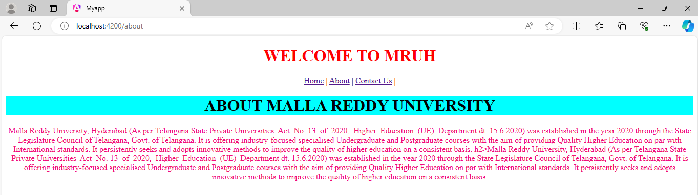
ANGULAR ROUTING-OUTPUT

Slide 57
THANK YOU

